Slide 1
Mathematics for Machine Learning
Session 1
7/26/2019
Dino de Raad

Slide 2
Roadmap

Slide 3
Goals
Goal for today’s session: Introduce core mathematical foundation for ML
Goal for introductory sessions: Interpretation of ML results, strengths and weaknesses of common models, intuitions on why ML models work and how they work from mathematical perspective
Goal for core sessions: Implement ML models from math foundation, focus on numeric optimization, model selection, and result quality

Slide 4
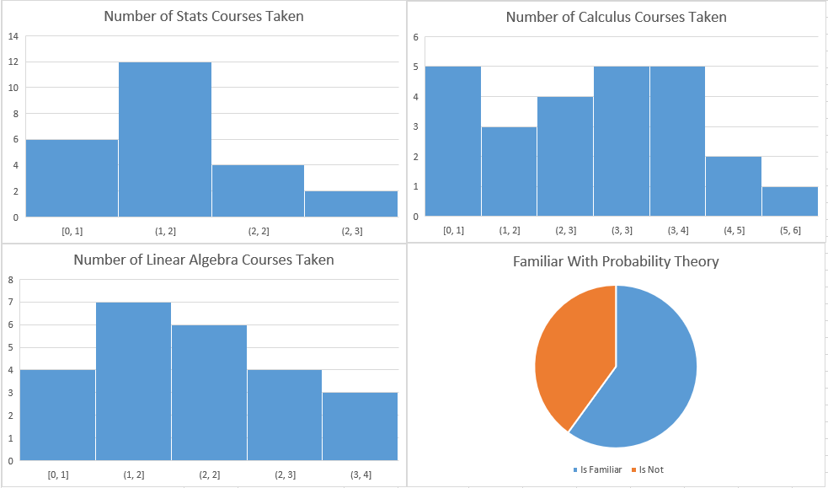
Survey Results
20%
24%
0
1
2
3
0
1
2
3
4
5
6
40%
16%
60%
0
1
2
3
4

Slide 5
Mathematics for Machine Learning

Slide 6

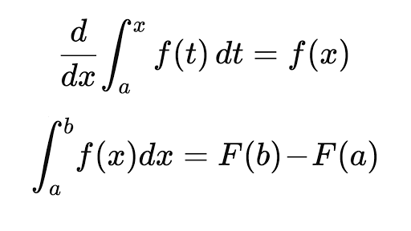




Mathematics Required
Linear Algebra
Calculus
Statistics
Probability

Slide 7
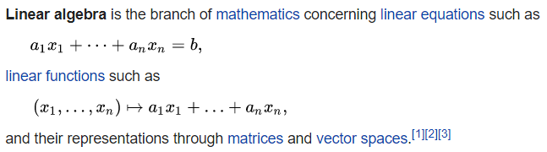
Linear Algebra
All data can be represented as a tensor, matrix or vector
All other math must be conceptualized in terms of linear algebra for computational efficiency
Matrix decomposition is fundamental for dimensionality-reduction techniques

Slide 8
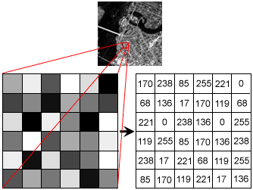
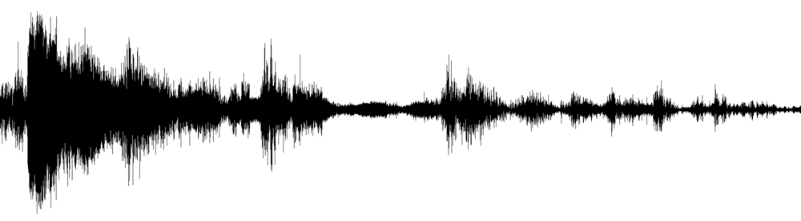

Linear Algebra

Slide 9
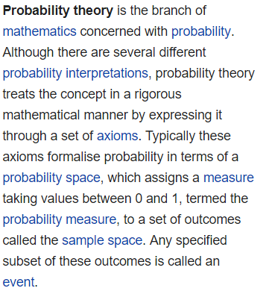

Probability and Statistics
Probability is fundamental to error measurements like log likelihood
Statistics is fundamental to interpretation of ML model results
[…]

Slide 10
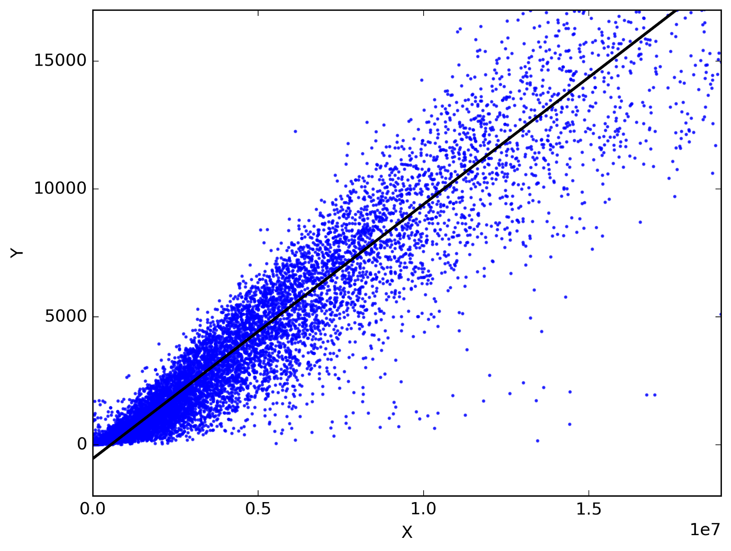
Maximum Likelihood Estimator
Joint probability that the data is explained given the model’s state
For example, what is the likelihood that m and b are correctly chosen
For linear regression, this is the sum of the squares of the residuals
Likelihood
m

Slide 11
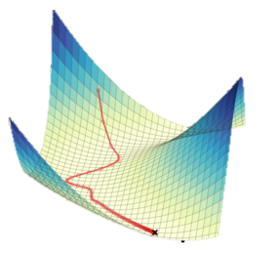
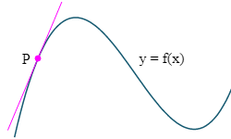
Calculus
[…]
Core of optimization mathematics
Derivatives required to perform gradient descent/backpropagation of the likelihood function

Slide 12

Gradient Descent
Try to find the minimum
We can use $m_{n+1}=m_{n}−γ\frac{∂l}{∂m}$ for some small $γ$
l
m

Slide 13
Goals of Machine Learning
Supervised
Regression
Classification
Unsupervised
Structure
Dimensionality Reduction
Others
Reinforcement Learning
Topic Modeling

